Slide 1
COVID and Workers’ Compensation
Malcolm Crosland Steinberg Law Firm Charleston, SC
1

Slide 2
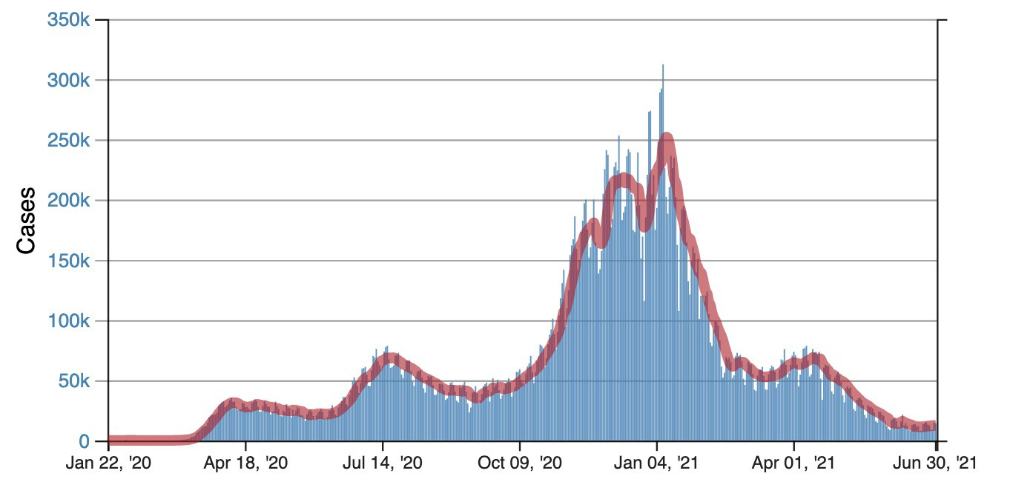
COVID Cases in the U.S.
Source: CDC COVID Data Tracker, July 2021
2

Slide 3
Number of COVID-19 Claims Filed in California, March 2020 – March 2021
45000
42522
40000
35000
30000
25000
Number of COVID claims filed
21452
20000
15339
16686
15000
12363
10000
6883
4434
5105
4646
5380
5000
3168
3890
1757
0
March
April
May
June
July
August
October
January
February
March
September
November
December
Source: California Workers’ Compensation Institute, 2021, California 2020 COVID-19 Workers’ Compensation Claims.
3

Slide 4
Total Number of Workers' Compensation Claims in California, 2019 compared to 2020
80000
70000
70662
64373
61453₆₀₅₈₉
60876
62040
60000
58119
59629
58558
57158
56515
52948
51286
51141
52992
50000
50321
48296
47012
41548
40000
33634
30000
20000
10000
0
July August
2019 2020
March
April
May
June
September
October
November
December
Source: California Workers’ Compensation Institute, 2020, California 2020 COVID-19 Workers’ Compensation Claims.
4

Slide 5
Number of COVID Claims in Florida, March 2020 – March 2021
9000
8252
Number of COVID WC Indemnity Claims
8000
7000
6000
5000
4638
4734
4063
4000
3415
3053
3000
₂₂₇₉ 2532
2000
1642
1686 1775
1782
1000
654
0
March
April
May
June
July
August
October
January
February
March
September
November
December
Source: Florida Division of Workers' Compensation 2020 COVID-19 Report, Data Summary as of March 31, 2021.
5

Slide 6
Total Indemnity Claims in Florida, 2019 compared to 2020
13903
14000
Number of Indemnity Claims
12000
10635
10000
9141
7866
8243
7899
8037
8102
8000
7457
7826
7475
7690
7250
70773102
719₆5₉₇₂
6605
6828
6637 6656
6765
6368
6000
4000
3544
2000
0
January
February
March
April
May
June July
2019 2020
August
September
October
November
December
Source: Florida Division of Workers' Compensation 2020 COVID-19 Report, Data Summary as of December 31, 2020.
6

Slide 7
COVID-19 Claims in Florida by Indemnity Benefits Paid
2%
3%
$0 to $4,999
$5,000 to $9,999
$10,000+
95%
Source: Florida Division of Workers' Compensation 2020 COVID-19 Report, Data Summary as of March 31, 2020.
7

Slide 8
COVID Claims Compared with All Other Claims in Florida, 2020
Claims Filed
Claim Cost
8%
31%
69%
92%
COVID Claims
All other claims
COVID claims
All other claims
Source: Florida Division of Workers' Compensation 2020 COVID-19 Report, Data Summary as of December 31, 2020.
8

Slide 9
COVID Workers' Compensation Claims in 2020 by Type of Claim
25%
Claims with only indemnity costs
Claims with medical costs
75%
Source: Courtney DuChene, 2021, "COVID-19 and Workers’ Compensation. It’s the Indemnity Costs, Really," Risk & Insurance, April 17,
2021; data from Mitchell.
9

Slide 10
The Medical Portion of Workers' Compensation Benefits has been Steadily Increasing
% of Total Benefits Attributable to Medical Benefits
60%
55%
_{50% 50%} ^{51% 51%} 50% 50% _{50%}
50%
49%
49%
_{48%} 48%
48%
_{46%} 47% _{46% 46%}
46%
45%
_{43%} 44%
42%
42%
_{40%} 40%
40%
35%
30%
2010 2013 2016
Source: National Academy of Social Insuranc1e.0
1995
1998
2001
2004
2007

Slide 11
The 10 States with the Highest Share of Workers' Compensation Benefits going to Medical Benefits
80.0%
78.0%
78.0%
76.0%
74.0%
72.0%
71.2%
70.0%
69.4%
68.8%
68.4%
68.0%
67.6%
67.2%
66.5%
66.3%
66.1%
66.0%
64.0%
62.0%
60.0%
Wisconsin
Indiana
Utah
Alabama
Arizona
Montana
Florida
Wyoming
New Hampshire
Arkansas
11

Slide 12
COVID-19 Presumptions
12

Slide 13
California COVID Claims by Industry (through April 2021)
22%
31%
Healthcare Public safety Retail Manufacturing Transportation Food services Other
5%
7%
8%
17%
10%
Source: California Workers’ Compensation Institute, 2020, California 2020 COVID-19 Workers’ Compensation Claims.
13

Slide 14
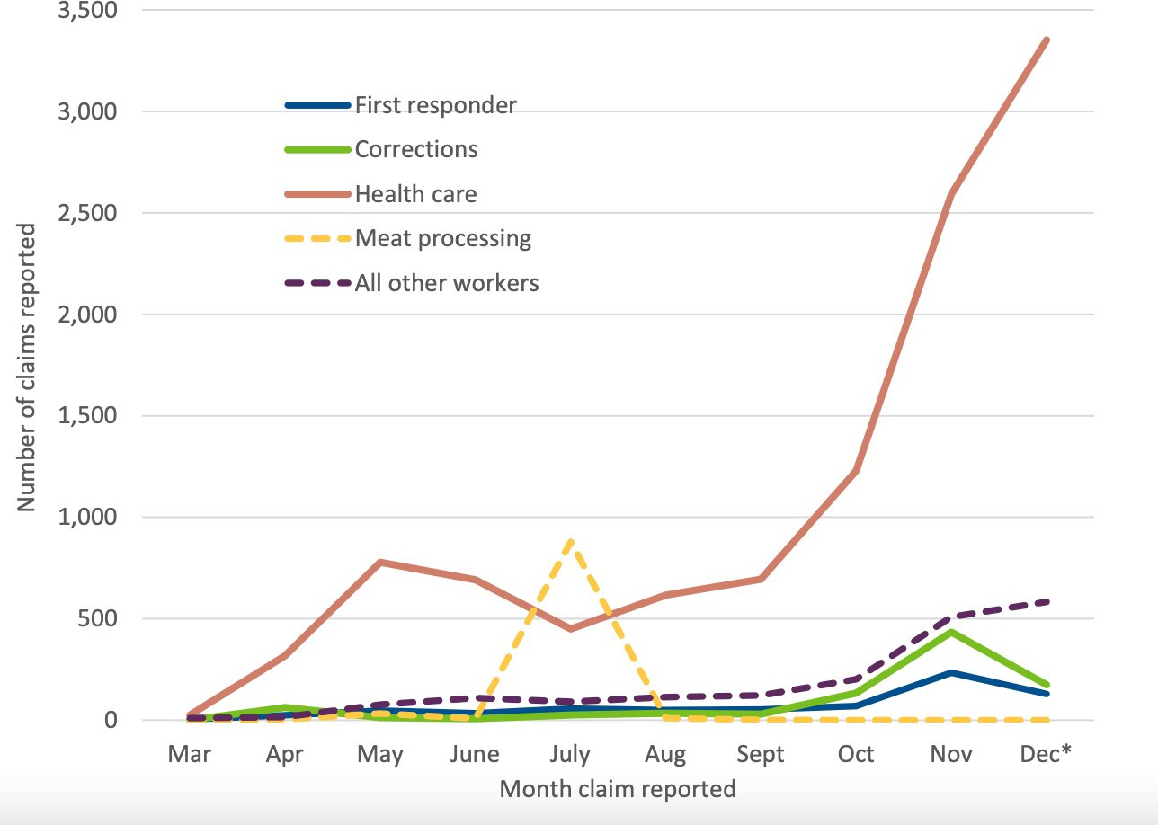
Monthly Reported COVID Claims by Presumption Worker Group, Minnesota, 2020
“Minnesota’s workers’ compensation response to COVID-19,” 2021, Minnesota Department of Labor and Industry.
14

Slide 15
Percent of Premiums Held as Operating Gains by Insurers Remained Strong through the Pandemic
30%
26%
25%
24%
25%
23%
Pretax operating gain (percent)
20%
17%
17%
15%
10%
5%
0%
2015 2016 2017
Source: NCCI, “WC Pretax Operating Gain,” 2021 State of the Line.
2018
2019
2020
15

Slide 16
The Effect of COVID-19 on the Workers’ Compensation Insurance Market:
“It's safe to say there doesn't appear to be any major concerns in these trends.”
-NCCI Chief Actuary, May 13, 2021
16

Slide 17
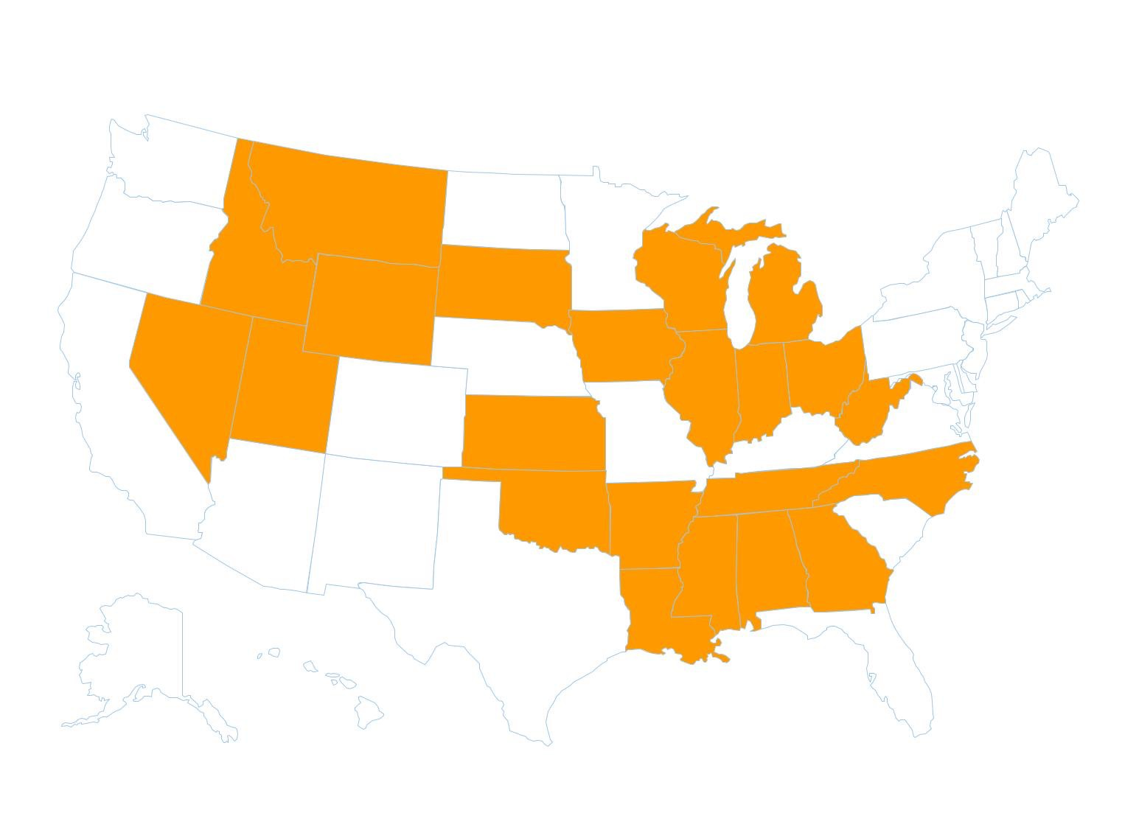
States with COVID Liability Shields for Businesses
Source: Honore N. Hishamunda and Kevin M. Young, 2021, State-by-state survey within
“COVID-19 Liability Shields: Today’s Legislative Trend, Tomorrow’s Legal Defense,” seyfarth.com, March 2021.
17

Slide 18
COVID-19 Claims in South Carolina
Vernon F. Dunbar | MGC Greenville

Slide 19
COVID-19 and Theories of Compensability
What is COVID-19?
A mild to severe respiratory illness that is caused by a coronavirus; is transmitted chiefly by contact with infectious material (such as respiratory droplets) or with objects or surfaces contaminated by the causative virus; and is characterized especially by fever, cough and shortness of breath and may progress to pneumonia and respiratory failure. (CDC Website)
Theories of compensability include pursuing benefits under the occupational disease statute (S.C. Code 42-11-10) or injury by accident theory (S.C. Code 42-1-160), and case law suggests that both are one and the same.

Slide 20
Occupational Disease Claims
South Carolina does not have enumerated conditions which constitute occupational diseases
42-11-10(A) defines “occupational disease” as “a disease arising out of and in the course of employment that is due to hazards in excess of those ordinarily incident to employment and is peculiar to the occupation in which the employee is engaged.”
A disease is considered an occupational disease only if caused by a hazard recognized as peculiar to a particular trade, process, occupation or employment as a direct result of continuous exposure to the normal working conditions of that particular trade, process, occupation or employment.

Slide 21
Occupational Disease Claims
Burden of Proof
Employee must prove by a preponderance of the evidence that the occupational disease arose directly and naturally from exposure in this State to the hazards peculiar to the particular employment

Slide 22
Occupational Disease: What it is Not (Section 42-11-10(B))
No disease is considered an occupational disease when it:
Does not result directly and naturally from exposure in this State to the hazards peculiar to the particular employment;
Results from exposure to outside climactic conditions;
Is a contagious disease resulting from exposure to fellow employees or from a hazard to which the workman would have been equally exposed outside of his employment.

Slide 23
To Prove an Occupational Disease
All six elements must be established:
A disease;
The disease must arise out of and in the course of the claimant’s employment;
The disease must be due to hazards in excess of those hazards that are normally incidental to employment;
The disease must be peculiar to the occupation in which claimant was engaged;
The hazard causing the disease must be one recognized as peculiar to a particular trade, process, occupation or employment; and
The disease must directly result from the claimant’s continuous exposure to the normal working conditions of the particular trade, process, occupation or employment.

Slide 24
Compensability of Occupational Diseases
Fox v. Newberry Cty. Mem’l Hosp.: 316 S.C. 537 (Ct. App. 1994) and 319 S.C. 278, 461 S.E.2d 392 (1995). SC Supreme Court Remanded case to Commission to make additional findings of fact.
The evidence in the case demonstrated a nurse frequently came into contact with patients who had the disease (herpetic whitlow), which was commonly manifested in the summertime through fever blisters.
The Court noted: [A] claimant must prove all six elements, by a preponderance of the evidence, to recover benefits for contraction of an occupational disease. The Court provided clarification on how to establish elements 3-6:
3. The disease must be due to hazards in excess of those hazards that are normally incidental to employment;
4. The disease must be peculiar to the occupation in which claimant was engaged;
5. The hazard causing the disease must be one recognized as peculiar to a particular trade, process, occupation or employment; and
6. The disease must directly result from the claimant’s continuous exposure to the normal working conditions of the particular trade, process, occupation or employment.

Slide 25
Fox v. Newberry Cty. Mem’l Hosp.
3. The disease must be due to hazards in excess of those hazards that are ordinarily incident to employment:
To do so, the evidence need only demonstrate that she was exposed to a greater risk by reason of her employment than the general public. Sturkie v. Ballenger Corp., 268 S.C. 536, 235 S.E.2d 120 (1977).

Slide 26
Fox v. Newberry Cty. Mem’l Hosp.
4. The disease must be peculiar to the occupation in which the claimant was engaged:
The phrase "peculiar to the occupation" does not mean the disease "must either originate exclusively from or be unique to the particular kind of employment in which the employee is engaged," nor does it mean the disease "must be one not otherwise found among the general public." Mohasco, 289 S.C. at 138, 345 S.E.2d at 253. Instead, the claimant must only show the disease is "either directly caused by, especially incident to, or the natural consequence of the work in question." Id.

Slide 27
Fox v. Newberry Cty. Mem’l Hosp.
5. The hazard causing the disease must be one recognized as peculiar to a particular trade, process, occupation or employment; and
In Fox, proven that the disease was peculiar to the medical profession because of the increased exposure to the virus.
Proven by Claimant testimony: regularly in physical contact with patients having fever blisters.
Expert testimony: opining that herpetic whitlow is more common in the medical profession because of the greater risk of exposure and contact to herpetic lesions.
Expert testimony citing scholarly studies: the literature in medical journals reports herpetic whitlow is most common in the medical profession.

Slide 28
Fox v. Newberry Cty. Mem’l Hosp.
6. The disease must directly result from the claimant's continuous exposure to the normal working conditions of the particular trade, process, occupation or employment.
In Fox, proven by Claimant’s testimony that she came into contact with patients daily by taking their temperature; thermometer rests on Claimant’s lips; thermometer is handled by nurse.

Slide 29
Fox v. Newberry Cty. Mem’l Hosp. Interesting Take-Aways Pertinent to COVID-19
Note: Defendants’ argument that disease transmitted through a one-time exposure, such as herpetic whitlow, was of a different character than previously-recognized occupational diseases, such as asbestos, silicosis and black lung, which result from gradual, continuous exposure, was discounted by the Court.
“The requirement that Claimant prove all six elements to prove an occupational disease compensable, protected workers’ compensation legislation from being used as a general health insurance plan.”
One-time exposure v. gradual/continuous exposure made no difference in terms of compensability if six elements proven

Slide 30
Fox v. Newberry Cty. Mem’l Hosp. Interesting Take-Aways Pertinent to COVID-19
Court also rejected Defendants argument that the claim should be deemed an injury by accident as opposed to an occupational disease
Court indicated this was “a distinction without difference,” leaving open the possibility of pursuing a claim under S.C. Code § 42-1-160, but insinuating it more appropriately fell under occupational disease statute.

Slide 31
COVID-19 an “Injury By Accident”?
S.C. Code 42-1-160(A):
"Injury" and "personal injury" mean only injury by accident arising out of and in the course of employment and shall not include a disease in any form, except when it results naturally and unavoidably from the accident and except such diseases as are compensable under the provisions of Chapter 11 of this title. (Occupational Disease).
In determining whether something constitutes an “injury by accident” the focus is not on some specific event, but rather on the injury itself. The word “accident” means an unlooked for and untoward event which is not expected or designed by the person who suffers the injury. No slip, fall or other fortuitous event or accident in the cause of the injury is required; the unexpected result or industrial injury is itself considered the compensable accident. Creech v. Ducane Co., 320 S.C. 559, 563, 467 S.E.2d 114, 116 (S.C. Ct. App. 1995).

Slide 32
Hiers v. Brunson Construction, Co.
Cases where compensability determined as injury by accident in disease case.
Held an employee who contracted pneumonia as a result of working on a roof during harsh elements and later died as a result was a compensable injury by accident
The exposure and chill suffered by deceased was greatly in excess of that suffered by his fellow employees or the public generally as he was on top of a building where he was fair target for the cold rain and wind. Such conditions are calculated to chill and wet one more than being on the ground or about the building generally.

Slide 33
Hiers v. Brunson Construction, Co.
Looked to heat stroke cases for guidance in finding pneumonia and eventual death claim compensable
The rule supported by the weight of authority…is that heat prostration which results from the employee's engaging in the employment, whether due to unusual or extraordinary condition or not, is to be deemed an accidental injury within the meaning of the statutes. Such an injury is accidental in that it is unforeseen and unexpected. If it results from the conditions under which the work is carried on, there is no reason why it should not be held compensable.

Slide 34
Muir v. C.R. Bard, Inc.
Claimant contracted Hepatitis C, most likely in the course of his employment inspecting catheters
Claimant had no significant “red flags” in his background, according to his primary care provider, that would subject him to Hepatitis exposure any more than a typical person in the general public, and therefore believed he contracted the disease at work.
The Court agreed with Claimant’s causation theory, and found the claim compensable as an occupational disease

Slide 35
How to Investigate COVID-19 Claims
Questions to ask:
Whether anyone the Claimant knows outside of work has symptoms of respiratory dysfunction or general illness;
Whether they have children and if so, whether they attend daycare;
The occupation of a Claimant’s spouse;
Whether any sporting events, concerts, events with large groups of people were recently attended;
Recent vacations—duration, location, and how they traveled (i.e., plane, train, etc.); etc.

Slide 36
How to Investigate COVID-19 Claims
In addition to the recorded statement, you will need to take the deposition of the claimant under oath in litigated cases.
Primary concern is gaging the Claimant’s credibility
Highly recommend that these be taken in person or via Zoom, so that the presentation of the witness can be evaluated by the attorney taking the deposition
Credibility is of great concern with the Commissioners, and is often the driving force behind determining whether a claim should be taken to a hearing or not.

Slide 37
How to Investigate COVID-19 Claims
Important to establish a timeline of exposure and symptoms to support causation defense:
More important in supporting denial of nonessential workers
When did symptoms begin?
Did any person in their household experience symptoms?
Work schedule and work duties for 2 weeks prior to experiencing symptoms?
Any travel, work-related or personal, in the 2 weeks prior to symptoms?

Slide 38
Vaccine
Are reactions to vaccine compensable? (Mandatory Injections v. Voluntary Injections)
Portee v. South Carolina State Hospital
Orderly at South Carolina State Hospital came in one morning suffering from a sore throat. He approached technician at hospital and requested medication. The technician administered a penicillin injection and the orderly went into anaphylactic shock and died.
Commission found that the injection requested was for the mutual benefit of the deceased orderly and the hospital given the injection “minimized the possibility of passing the infection to the hospital’s patients.”
The Court held that: “It is true the injection of penicillin was not an accident. It was expected and intended, but the tragic result was “wholly unexpected and unintended” thereby constituting the element of “accident.”

Slide 39
The Effects of Covid-19 on an Employer
Lara Browne: Legal Counsel: Roper St. Francis Healthcare, Charleston

Slide 40
Daily Challenges
Protecting Employees and Staff
Protecting Patients and Visitors
Staying Fully/Partially Staffed
Financial Concerns
Communication with Employees Out-of-Work
Tracking Exposures
Determining Work-Related Exposure

Slide 41
Response Activities
Command Staff Briefings
Teammate Focused Strategies
(VS, Recorded Briefings, Careline)
General Public
Patients and Support Persons
Comprehensive Media Strategy
Aggregation of lessons learned
Formalizing Actionable Knowledge
Future Incident Planning
New Normal Operations
Internal & External
Communications
Continued Practices
Drive Thru Testing Sites
COVID Inpatient Cohort Units
Telehealth Program Expansion
Patient Navigation Policy
De-escalation Policy
Testing for Procedural Areas
Visitation Policy Changes
Post Acute Care Management
HealtheAnalytics Data Analysis
COVID Cost Center
Wage Continuation
Emergency Assistance Fund
Public Assistance Grant
CARES Act Funding
FCC COVID Telehealth Grant
State & Federal Reporting
System Wide
Incident Response
& Command Center
Operations
Inpatient &
Outpatient
Operations
Finance &
Compliance
Negative Pressure Rooms
Security & Access Control
Supply Chain Management
PPE Acquisition & Stockpiling
PPE Guidance and Education
Ventilators & Airway Supplies
Infrastructure &
Supply Chain
Teammate
Support
Labor Pool
Virtual Onboarding & Education
Telework Plan
Employee Assistance Program
Contracted Critical Care RN’s
Exposure Advisor & Teammate Health
Notes:
All of our response actions fall into 6 buckets

Slide 42
Initial Contact Screening
Web-encounter Form
Teammate Health Phone Line – M-F 8:00-4:00
Call Center after hours
Nurses and Occupational Medicine Team
Determines nature of call and appropriate next step
Routes to appropriate work queue for definitive management
Exposure Advisor

Slide 43
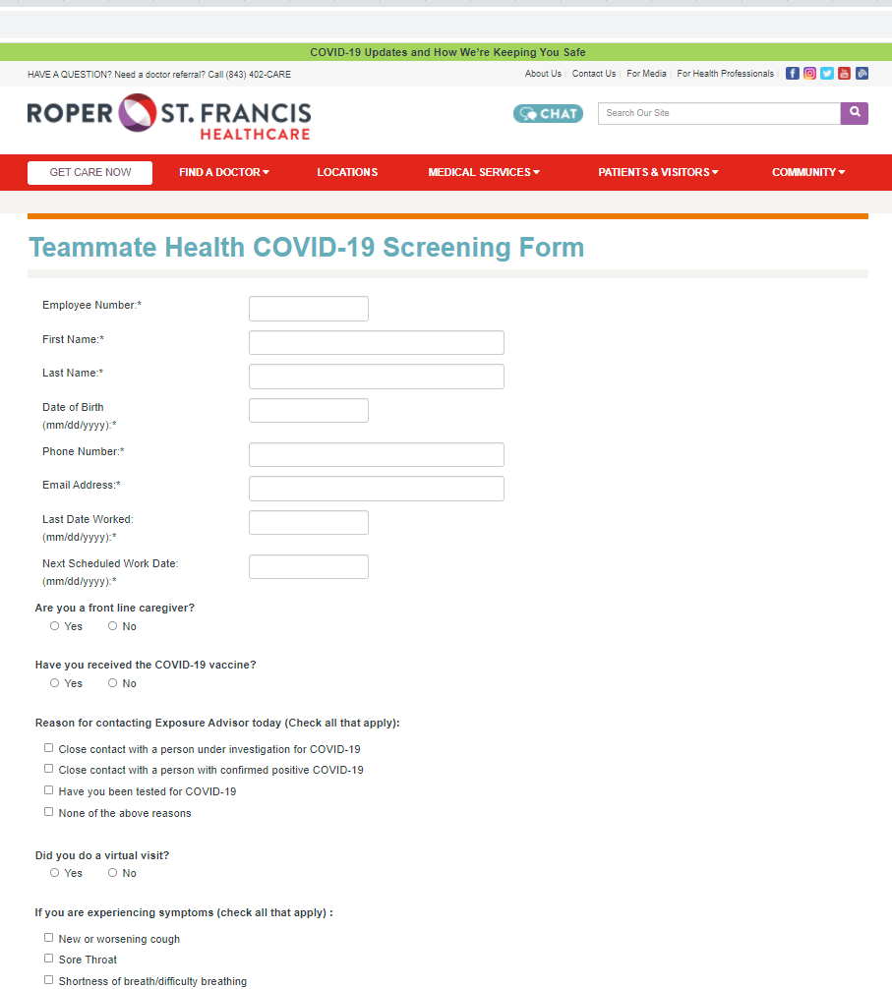

Slide 44
Exposure Advisor: Roles and Responsibilities
Conduct Initial Phone Visits with Symptomatic Teammates/Asymptomatic Teammates with Known Exposure
Evaluation Phase
Assess for COVID-19 Related Symptoms
Assess for Known Exposures (may be asymptomatic)
Determine and Record Symptom Onset Date
Testing Needed? (Check to see if testing already performed)
Teammate Out-of-Work and Quarantined
Follow-up to Relay Results
Teammate Result Communication by RN with Symptom Reassessment
Follow-up with Positive Teammates to Assess and Determine RTW Readiness and Clearance

Slide 45
Employees Requesting Work Accommodation Consideration
Requests come in through Exposure Advisor
Health History Reported on Separate Form
Teammate and History Reviewed by Physician Panel
Risk Determination Made
Decision Communicated to Teammate, Manager and HR
Teammate May Appeal
Those Determined to be At Risk Work with Their Manager to Determine Work Options
Employees Requesting Work Accommodation Consideration

Slide 46
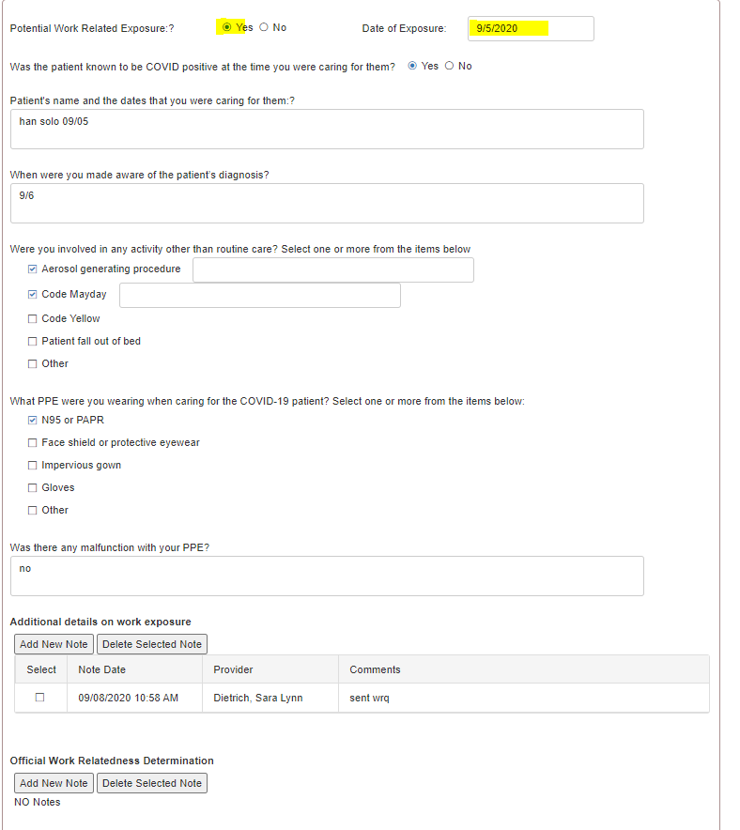
Possible Work-Related Exposure?
Record details of exposure

Slide 47
Work-Related?
Exposure Advisor Team Conducts Telephone Interview and Reviews Completed Form
Case Enters a “Pending” Status While a Determination is Made. The Employee is on Quarantine during this time.
Panel Team (Composed of Doctors and Nurses) Make Determination on Work-Relatedness
I.e., Did the Exposure to Covid-19 More Likely Than Not Occur at Work?

Slide 48
Work-Related?
Factors Considered by Panel:
Department employee was working in at the time of alleged exposure?
Low Risk versus High Risk? Controlled environment?
Known exposure to a patient or visitor?
Known exposure to a coworker who subsequently tests positive?
Using proper PPE/Protection at time of alleged work-related exposure?
Following protocol and rules set by Roper St. Francis Healthcare? (May not change work-relatedness but could cause question about compensability)
Exposure Outside of Work Environment?
Family Members, Recent Travel, Daily Activities, Etc.
Any other information that may impact the decision

Slide 49
Total # Positive | 978
Work-Related Allegation | 65
Determined to be Work-related | 35 (pending decisions not included)

Slide 50
Mandating The Vaccine
Federal Equal Employment Opportunity laws (EEO) do NOT prevent an employer from requiring all employees physically entering the workplace to be vaccinated for Covid-19, but they must offer certain exemptions:
Medical/Disability
Religious
Reasonable Accommodations for Employees who do not get vaccinated due to disability/medical or religious beliefs as long as they do not pose an undue hardship to the employer or others.
RSFH: must always wear a mask when on the property

Slide 51
Workers’ Compensation Liability for Adverse Reactions from Mandatory Vaccines?
Lee v. Wentworth Manufacturing Company (1962)
TB test while at work; Claimant subsequently developed infection at site where the test was administered
Commission determined this constituted an injury by accident which arose out of and in the course of her employment
Decision says the general rule is “incapacity caused by illness from vaccination or inoculation may properly be found to have arisen out of the employment where such treatment is submitted to pursuant to the direction or for the benefit of the employer, but the rule is otherwise where the employee voluntarily avails himself of such treatment solely for his own benefit.”
Mutual benefit of both employee and employer (similar to finding in Portee v. South Carolina State Hospital)
May be a different outcome if the state of South Carolina/DHEC mandates the vaccine for everyone due to the pandemic

Slide 52
Covid-19 & Workers’ Compensation Claims
Covid-19 claims are unique, and no two are exactly the same
Covid-19 symptoms are constantly being updated/changed as medical professionals continue to learn/ New variants (Delta)
Growing number of people who have the virus experience mild to moderate symptoms for a prolonged period of time (aka “long-haulers”)
Treatment often involves medical specialists that do not typically treat workers’ compensation patients
Cardiologist, Pulmonologist, Gastroenterologist, ENT, Infectious Disease, etc.
Difficult to find providers willing to treat a WC patient; Difficult to obtain Form 14B

Slide 53
Covid-19 & Workers’ Compensation Claims
Medical Causation often not straightforward
Pre-existing conditions/Comorbidities
Objective versus Subjective Conditions
Symptoms reported by Covid-19 patients which can be visibly observed and/or are quantifiable and diagnosed with some type of diagnostic testing (objective) tend to be easier to manage.
Examples: shortness of breath, scarring of lungs, rapid heartbeat, inflammation of the heart, hair loss
Medical causation can be better addressed when quantifiable information to review (although still difficult while Covid-19 continues to evolve)
Aggravation of pre-existing condition easier to determine if doctor has prior quantifiable information available to compare to updated testing.
Symptoms reported by Covid-19 patients which cannot be visibly observed or diagnosed by testing/imaging (subjective) often harder to manage.
Examples: “brain fog,” memory issues, fatigue, headaches, difficulty concentrating, depression/anxiety, etc.
Medical causation can be difficult for doctors to address when no objective evidence, but their patient continues to report subjective symptoms.
More difficult to state with medical certainty that patient suffered an aggravation of a pre-existing condition without objective measures (patients' credibility often plays a big role)

