Slide 1
Diversity in Workers’ Compensation
Danny Vega, Esquire
Chappell, Smith & Arden, P.A
Kenya Miller, Esquire
Dickie McCamey Chilcote, P.C.
Joe Wideman, Esquire
Atkins Law Farm

Slide 2
How diverse are the stakeholders?
A stakeholder is any party involved in a workers compensation claim. Any stakeholder in the claim has the ability to affect the claim in some way, though the extent varies from party to party.

Slide 3
How diverse are the stakeholders?
The Usuals:
The Injured Worker
The Insurance Carrier/TPA
The Employer
The Medical Providers
Attorneys

Slide 4
the diversifying workforce
The U.S. population in 2019 was approximately 328.3 million.
168.6 million persons worked at some point during 2019.
The proportion of the civilian non-institutional population age 16 and over who worked at some time during 2019 was 64.9 percent.

Slide 5
the diversifying workforce
Among the major race and ethnicity groups, the proportions who worked at some time during 2019 was as follows:
67.9 percent Hispanics
66.1 percent Asians
65.1 percent Whites
62.8 percent Blacks

Slide 6
the diversifying workforce:
composition of the labor force by race
Whites 77%
Blacks 13%
Asians 6%
American Indians and Alaska Natives 1%

Slide 7
the diversifying workforce:
composition of the labor force by race
People of Hispanic or Latino ethnicity, who may be of any race, made up 18% of the total labor force.
By detailed ethnicity, the majority of Hispanics in the labor force were Mexican (61%).
***[BLS Reports dated December 2020]***

Slide 8
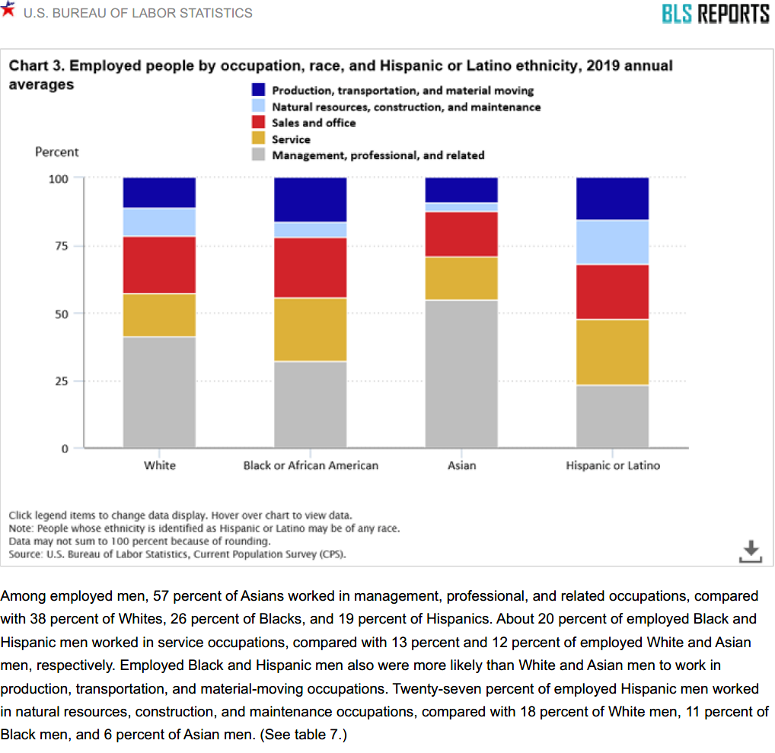
the diversifying workforce

Slide 9
the diversifying workforce
FUTURE PROJECTIONS
The Pew Research Center projects that nearly one in five Americans (19%) will be foreign born in 2050, well above the 2005 level of 12%.

Slide 10
the diversifying workforce
FUTURE PROJECTIONS
Non-Hispanic whites, who made up 67% of the population in 2005, will be 47% in 2050.
Hispanics will rise from 14% of the population in 2005 to 29% in 2050.

Slide 11
the diversifying workforce
FUTURE PROJECTIONS
Blacks were 13% of the population in 2005 and will be roughly the same proportion in 2050.
Asians, who were 5% of the population in 2005, will be 9% in 2050.

Slide 12
CLAIMS ADJUSTER STATISTICS
There are over 5,258 workers' compensation claims adjusters currently employed in the United States.
67.6% of all workers' compensation claims adjusters are women, while only 27.8% are men.

Slide 13
CLAIMS ADJUSTEr STATISTICS
The average age of an employed workers' compensation claims adjuster is 43 years old.
The majority of workers' compensation claims adjusters are located in Atlanta, GA and Dallas, TX.
New Jersey is the best state for workers' compensation claims adjuster to live.

Slide 14
CLAIMS ADJUSTER STATISTICS
composition by race
White (66.1%)
Hispanic or Latino (14.8%)
Black or African American (11.0%)

Slide 15
CLAIMS ADJUSTER STATISTICS

Slide 16
The Bloomberg Study: Measuring Diversity within U.S. Companies
As part of an initiative to track the corporate response to the Black Lives Matter movement, Bloomberg has obtained detailed breakdowns of U.S. employee counts by race and gender across job categories for 37 out of 100 of the nation’s biggest corporations.

Slide 17
The Bloomberg Study: Measuring Diversity within U.S. Companies
THE RESULTS
The data obtained by Bloomberg paint a picture of companies still struggling to add more Black and Hispanic workers, especially in the upper ranks.

Slide 18
The Bloomberg Study: Measuring Diversity within U.S. Companies
Only 4 of the 37 companies had Black people in 10% or more of executive and management roles, even though Black people make up about 13% of the U.S. population.
Hispanic representation also trailed national figures at many companies.
The representation figures were often worse for women of color.

Slide 19
The CURRENT STATE OF CULTURAL DIVERSITY IN HEALTHCARE
Many medical facilities are falling short of providing a diverse group of healthcare providers that reflects the varying cultures, races and ethnicities of patients they serve.

Slide 20
The CURRENT STATE OF CULTURAL DIVERSITY IN HEALTHCARE
COMPOSITION OF PHYSICIANS BY RACE
White – 56.2%
Asian – 17%
Hispanic – 5.8%
Black – 5%
American Indian or Alaska Native – 0.3%

Slide 21
The CURRENT STATE OF CULTURAL DIVERSITY IN HEALTHCARE
Figures from the Association of American Medical Colleges (AAMC) show that 46.8% of medical school applicants are white.

Slide 22
The CURRENT STATE OF LAW FIRM DIVERSITY
A 2019 study of over 1,000 offices of major law firms in the US found that in 2018:

Slide 23
The CURRENT STATE OF LAW FIRM DIVERSITY
Women comprised 35.41% of the attorneys
Racially or ethnically diverse attorneys represented 16.1%
Racially or ethnically diverse women were 8.08%
2.86% were LGBTQ attorneys,
0.53% were attorneys with disabilities.

Slide 24
The CURRENT STATE OF LAW FIRM DIVERSITY
COMPOSITION OF MINORITY PARTNERS
The survey also found that in 2018, 23.36% of firm partners were women, 9.13% were racially or ethnically diverse, and 3.19% were racially or ethnically diverse women.

Slide 25
what can we take away from these numbers
Although the rate at which the country’s labor force continues to diversify this trend is not equally mirrored in the industries of other stakeholders.

Slide 26
what can we take away from these numbers
In short, a diverse or minority injured worker most likely will have a supervisor, claims adjuster, doctor, nurse case manager, and/or attorney who doesn’t share his or her culture.

Slide 27
Why should we care about the trending diversifying workforce?
Understanding unconscious bias and being a culturally competent stakeholder in workers compensation saves time, paperwork, produces higher engagement and ultimately leads to a more efficient and better means of serving injured workers and….

Slide 28
Why should we care about the trending diversifying workforce?
REDUCES CLAIMS COSTS OVERALL

Slide 29
Why should we care about the trending diversifying workforce?
LET’S TALK MONEY AND COSTS SAVINGS
Interested stakeholders in this industry are often required to investigate clams, determine compensability and any defenses and maintain low claims costs where feasible.

Slide 30
Why should we care about the trending diversifying workforce?
When injured workers are not understood based on cultural background, they really feel isolated ... and this could affect healing time and costs.

Slide 31
Why should we care about the trending diversifying workforce?
Studies show that particular racial/ethnic groups received poorer standards of care due to bias of health care providers. This can impact compliance with medical treatment, trust in the physician/patient relationship, and ultimately treatment outcomes and delayed return to work.

Slide 32
Why should we care about the trending diversifying workforce?
Lack of diversity and cultural incompetence can lead to increased expenses for:
Medical treatment
Translation/interpreting services
Longer recorded statements and depositions
Additional indemnity benefits
Extensive litigation costs

Slide 33
the road to diversity, cultural COMPETENCY, AND INCLUSION
Be honest with yourself
We come to understand who we are by understanding who we are not.
Understanding unconscious bias is taking a step towards cultural competency.

Slide 34
the road to diversity, cultural COMPETENCY, AND INCLUSION
Unconscious bias is defined as social stereotypes about certain groups of people that individuals form outside their own conscious awareness.

Slide 35
the road to diversity, cultural COMPETENCY, AND INCLUSION
Cultural Competency is defined as the ability of individuals and systems to work or respond effectively across cultures in a way that acknowledges and respects the culture of the person or organization begin served. (Williams 2001)

Slide 36
the road to diversity, cultural COMPETENCY, AND INCLUSION
How Can Industry Stakeholders Achieve Cultural Competency?
Hiring people from diverse backgrounds that make up the incoming worker population
Through training on cultural competence and unconscious bias.
Adding diversity and inclusion initiatives and goals to the fabric of your organization

Slide 37
the road to diversity, cultural COMPETENCY, AND INCLUSION
Post George Floyd/BLM protests more companies have taken steps to improve their diversity.
Adding chief diversity officers
Setting targets for representation of minority groups
Establishing pipeline programs with HBCUs
Adding people of color to their boards.

Slide 38
How do we develop an attitude and components of cultural competence?
Practice openness – demonstrate acceptance of difference
Be flexible – demonstrate acceptance of ambiguity
Demonstrate humility – through suspension of judgment and ability to learn
Be sensitive to others – appreciate cultural differences
Show a spirit of adventure – show curiosity and see opportunities in different situations
Practice positive change or action – demonstrate a successful interaction with the identified culture

Slide 39
How do we develop an attitude and components of cultural competence?

Slide 40
Questions
Questions

