Slide 1
Promoting Civil Advocacy
2021 SCWCEA Educational Conference Breakout Session

Slide 2
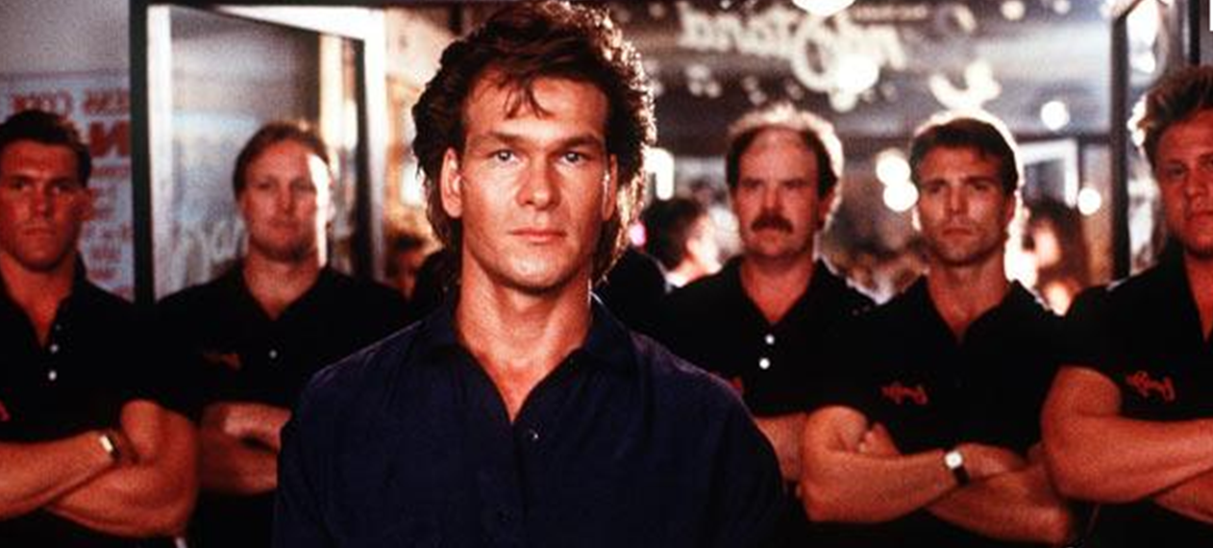
Civil Advocacy: Road House Style

Slide 3
Civil Advocacy: Road House Style
Dalton: All you have to do is follow three simple rules. One, never underestimate your opponent. Expect the unexpected. Two, take it outside. Never start anything inside the bar unless it’s absolutely necessary. And three, be nice.
Dalton: If somebody gets in your face and calls you a **********, I want you to be nice. Ask him to walk. Be nice. If he won't walk, walk him. But be nice. If you can't walk him, one of the others will help you, and you'll both be nice. I want you to remember that it's a job. It's nothing personal.
Steve: Being called a ********** isn't personal?
Dalton: No. It's two nouns combined to elicit a prescribed response.
Dalton: Nobody ever wins in a fight.

Slide 4
How has technology impacted civility?

Slide 5
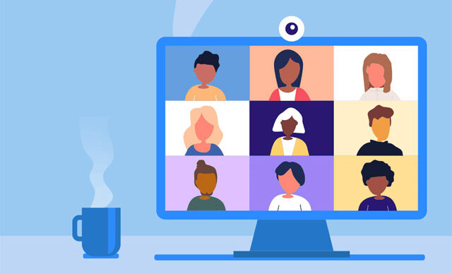
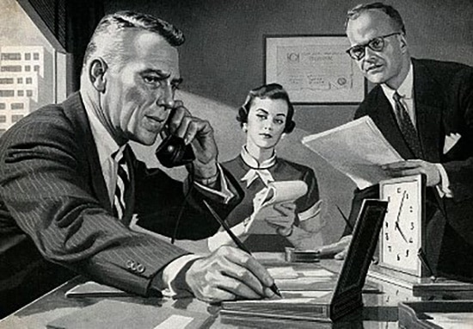
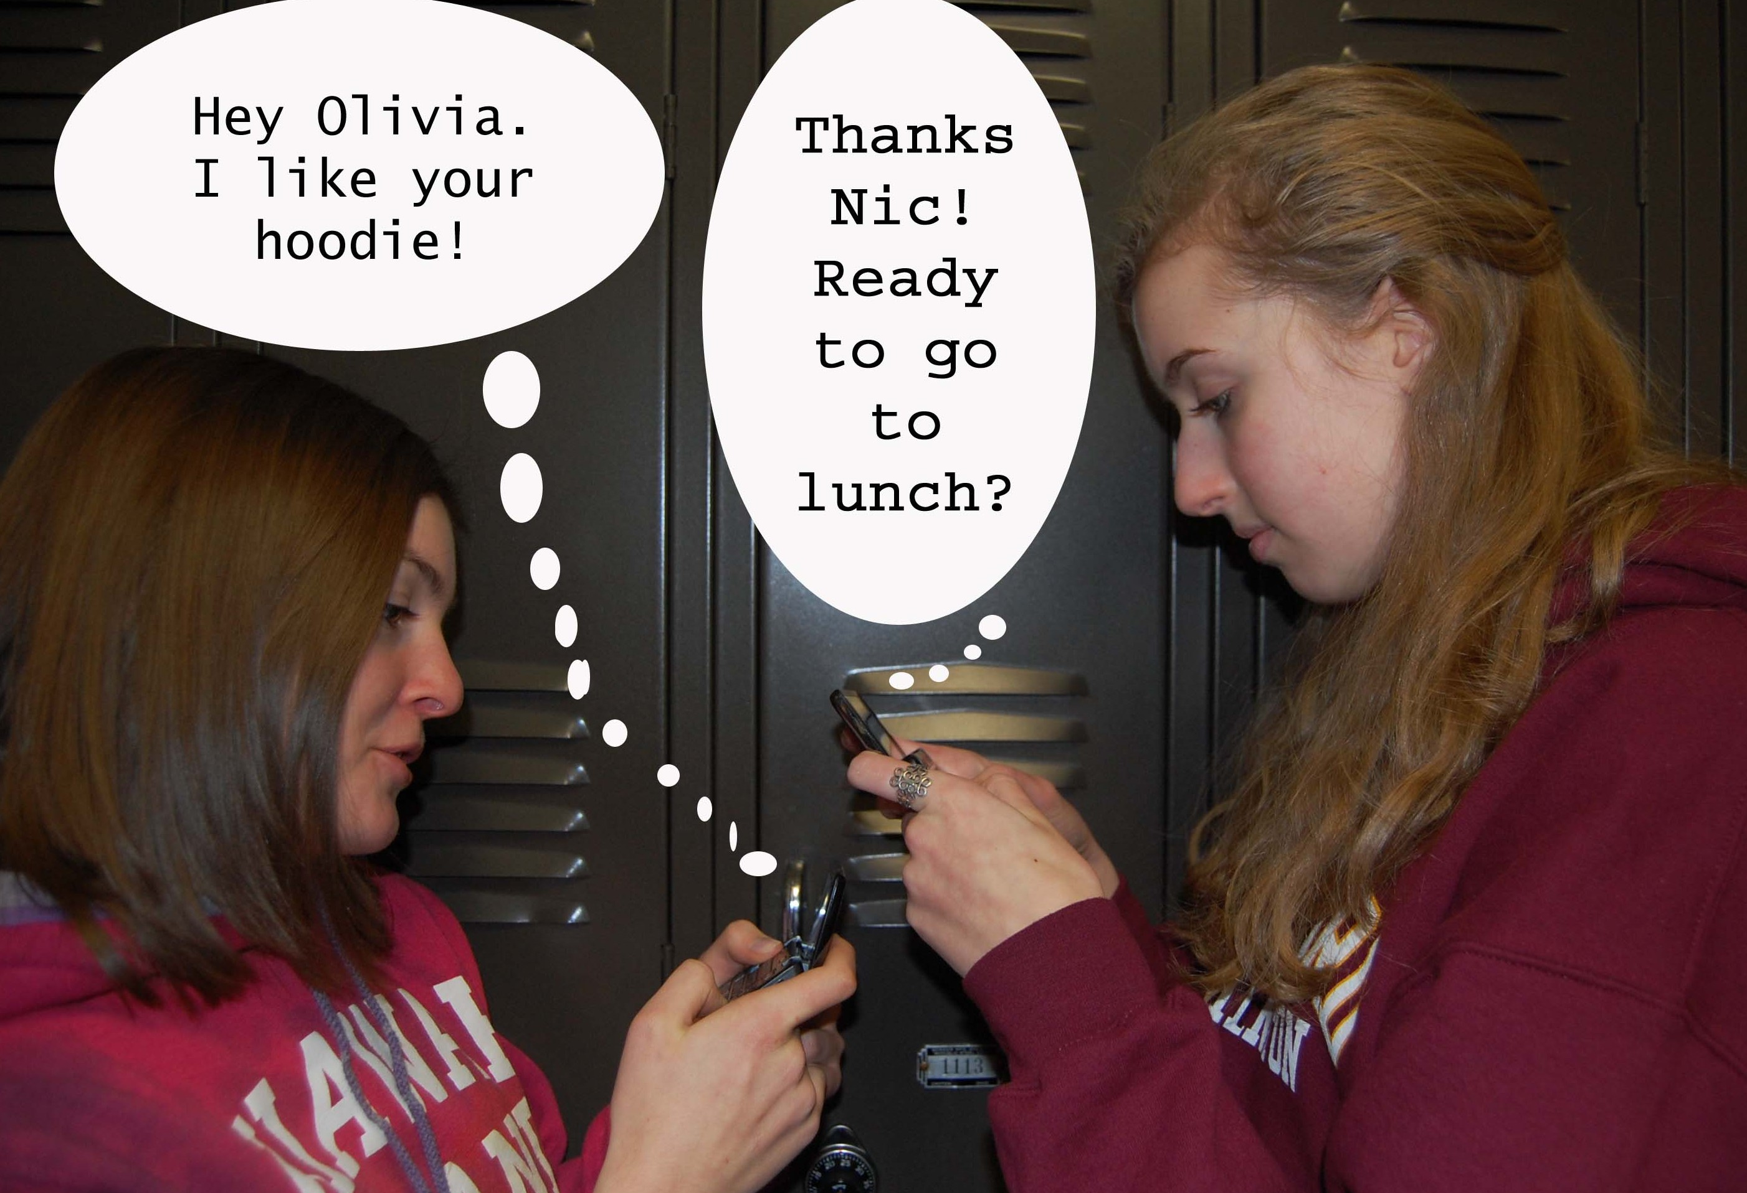
Communication Tools or Barriers?

Slide 6
How can we enhance civility & collaboration?

Slide 7
Photo Collage

